Slide 1


Planning Within a Bioregion
Vermont 2050: Rethinking the Urban-Rural Relationship
Marc Lapin
Associate Laboratory Professor
College Lands Conservation and Management Specialist
Middlebury College

Slide 2
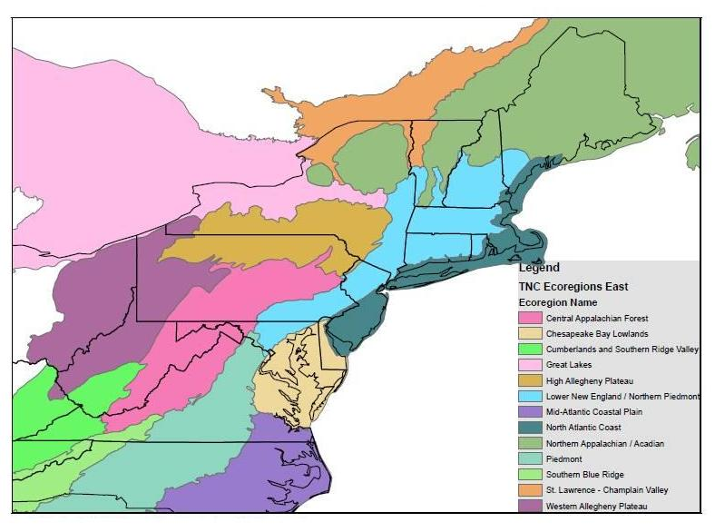
Regional Plans, a variety with
various purposes,
for example,
Wildlands and Woodlands
New England Food Vision
Vermont Conservation Design
St. Lawrence – Champlain Valley Ecoregional Plan
Champlain Valley Bird Initiative

Slide 3
Vermont Conservation Design
Sorensen, Zaino, Hilke, & Thompson, 2015

Slide 4
Lapin, Crosby, Valen & Oberg, 2015

Slide 9
THANK YOU
QUESTIONS?

