Slide 1
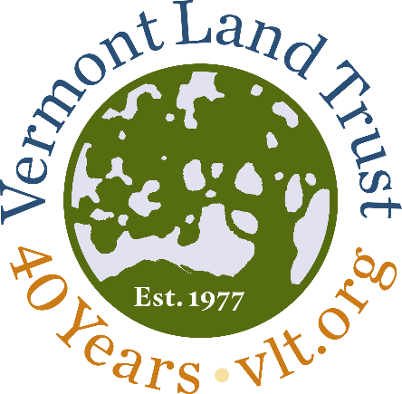
Vital, Resilient, Connected.
A vision for Vermont’s Working Landscape

Slide 2
Our Mission
The Vermont Land Trust exists to ensure current and future generations are deeply connected to the land and benefit from its deliberate protection and responsible stewardship.

Slide 3
We live in a time of rapid and accelerating change...
Agricultural Economy
Intergenerational Transfer of Land
Climate Change
Changing relationship to Land
Demographic Shifts

Slide 4
We must look beyond traditional conservation and stewardship tools and mindsets.

Slide 5
Our Vision, Today
Vermont’s communities and working landscape will be
vital, resilient, and connected as a result of the work that we do.

Slide 6
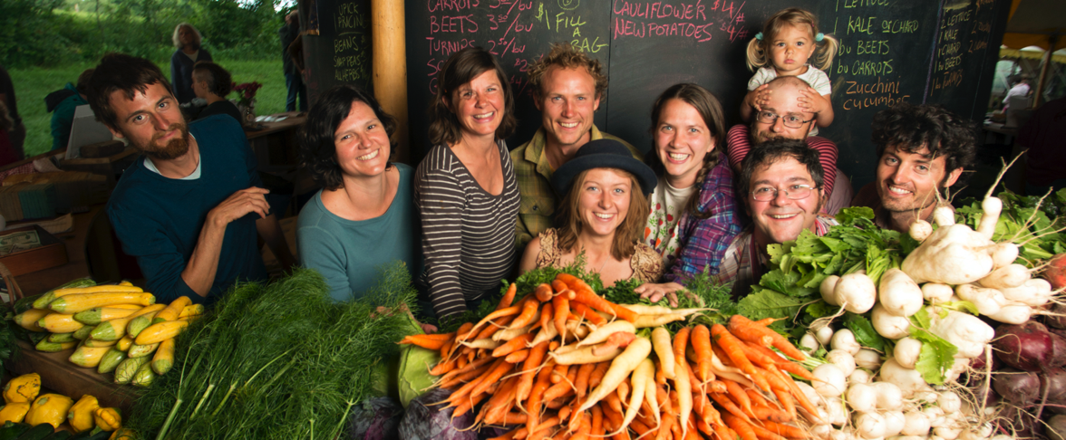
VITAL

Slide 7
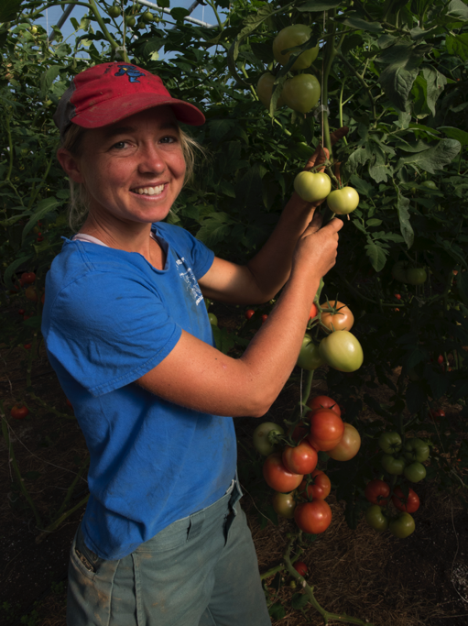
VITAL

Slide 8
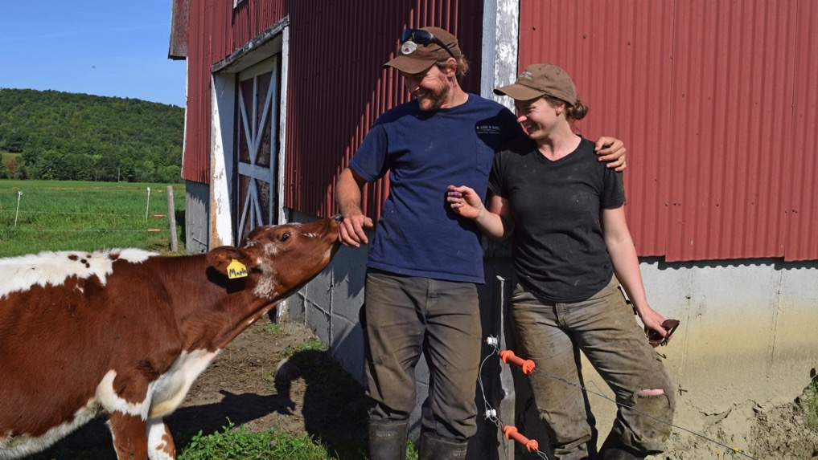
VITAL

Slide 9
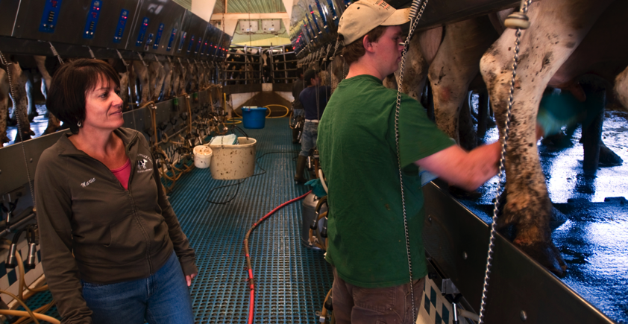
VITAL

Slide 10
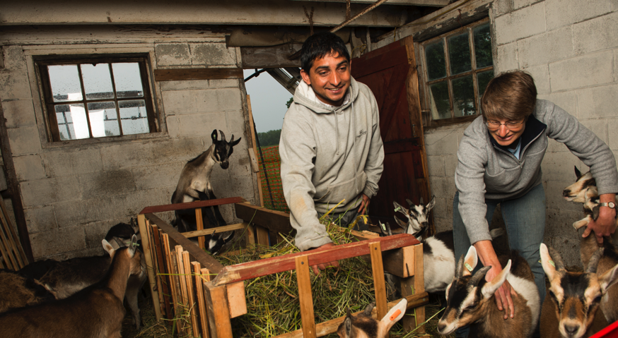
VITAL

Slide 11
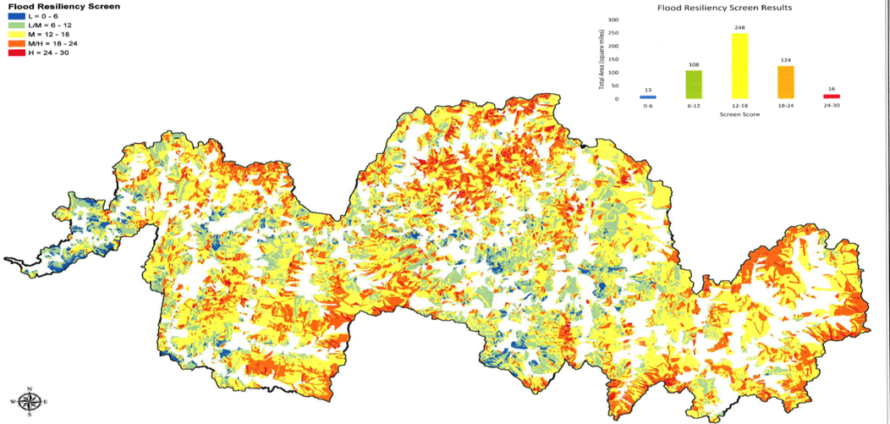
RESILIENT
Smugglers
Notch

Slide 12
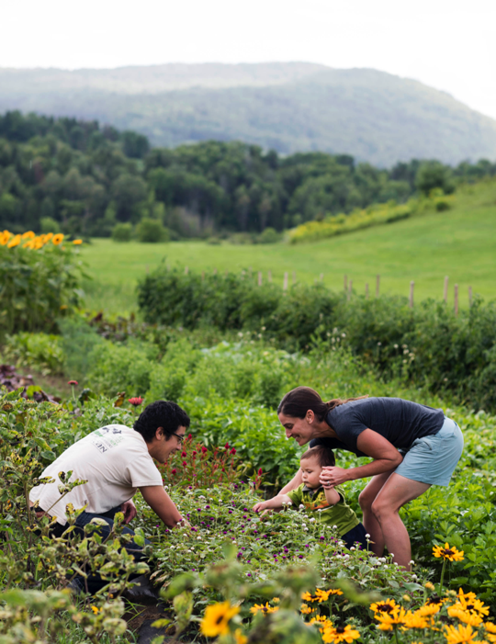
RESILIENT

Slide 13
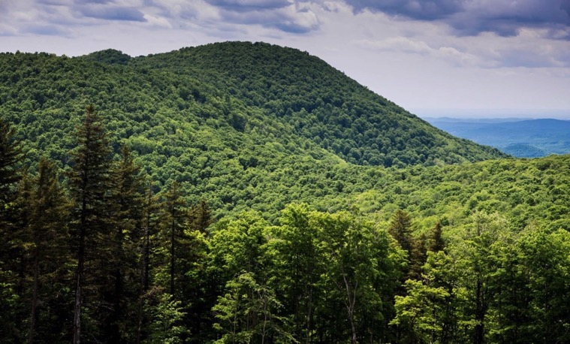
RESILIENT

Slide 14
RESILIENT

Slide 15
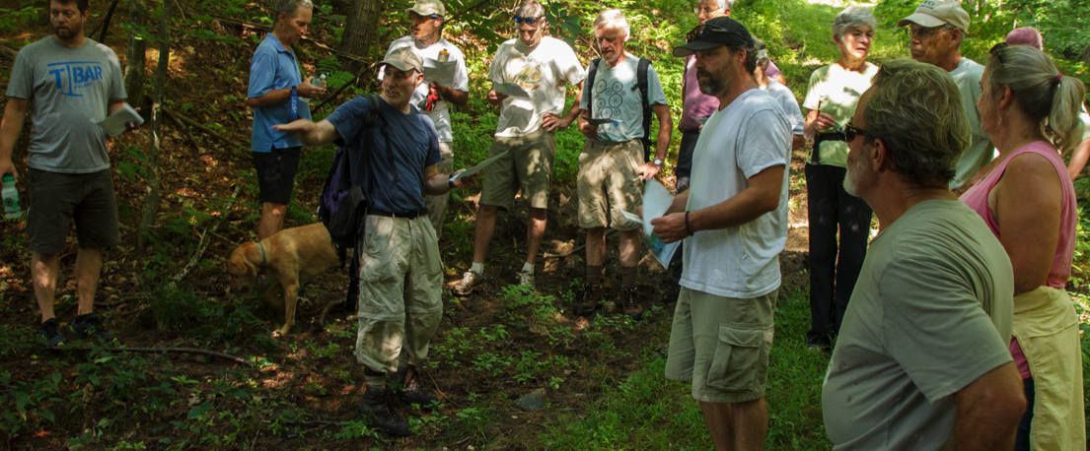
CONNECTED

Slide 16
CONNECTED

Slide 17
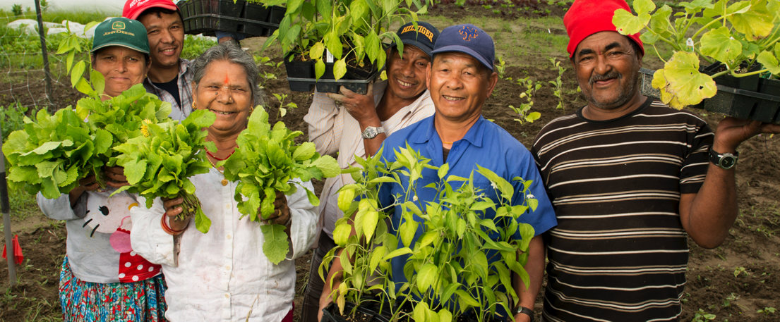
CONNECTED

Slide 18
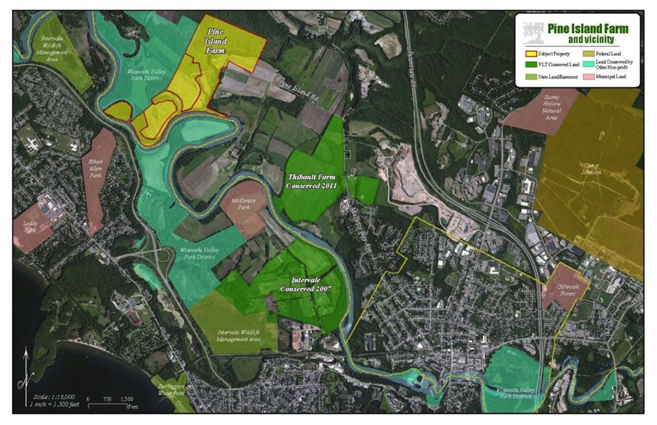
CONNECTED

Slide 19
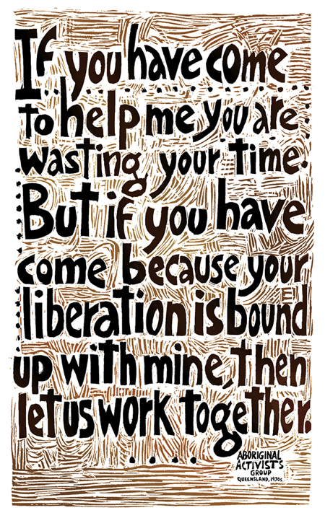

Slide 20
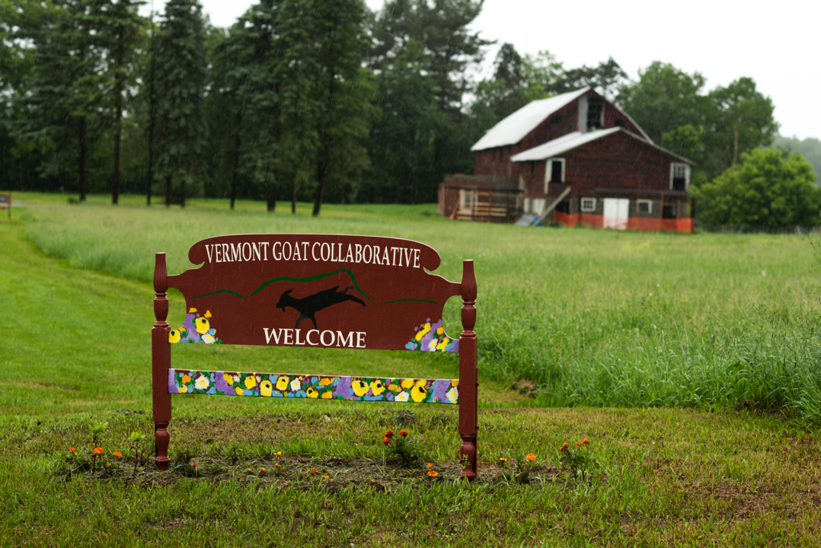

Slide 21
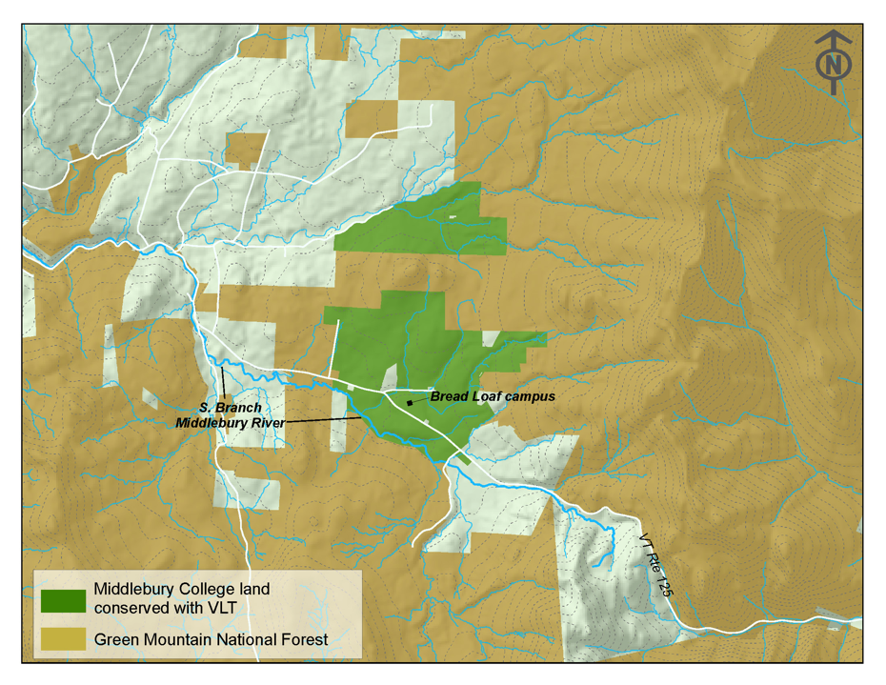

Slide 22
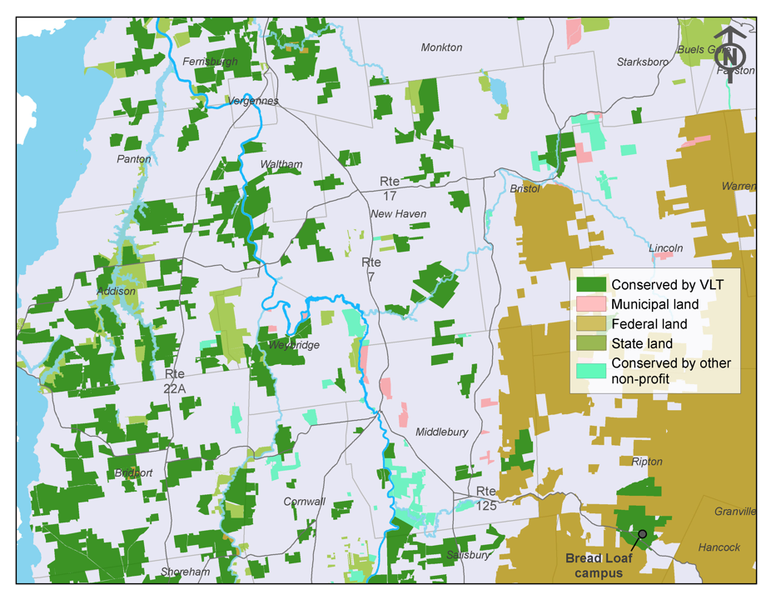

Slide 23
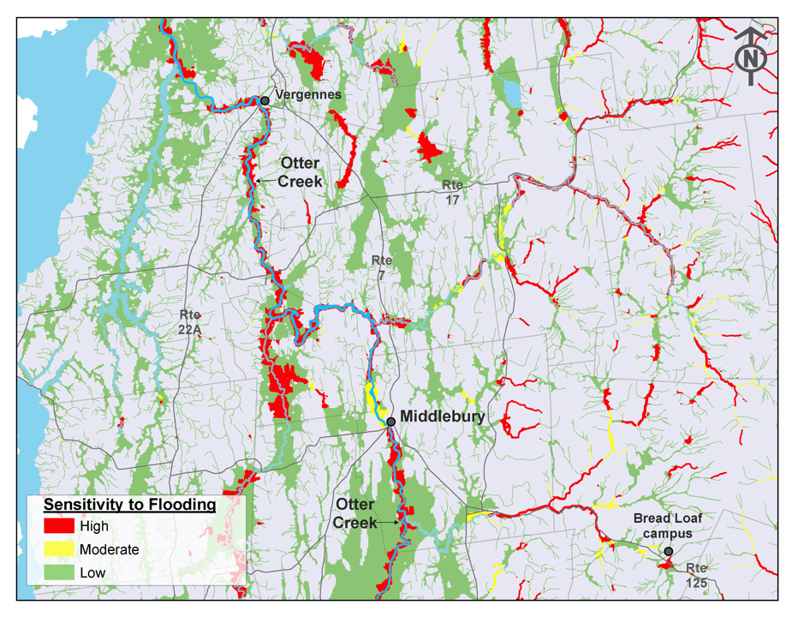

Slide 24
